Slide 1
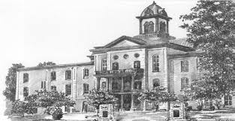
Criminal Justice Needs Assessment
Final Presentation
May 19, 2014
HAMBLEN COUNTY, TENNESSEE

Slide 2
Primary Tasks
Review current conditions of the Justice Center
Assess County Arrest Trends and Project Judicial Caseload, Inmate Population and Required Jail Bed Spaces for next 20 Years
Determine Feasibility of Expansion or Renovation of the Justice Center to accommodate future growth
Determine Options for the Future Needs of the Criminal Justice System.

Slide 3
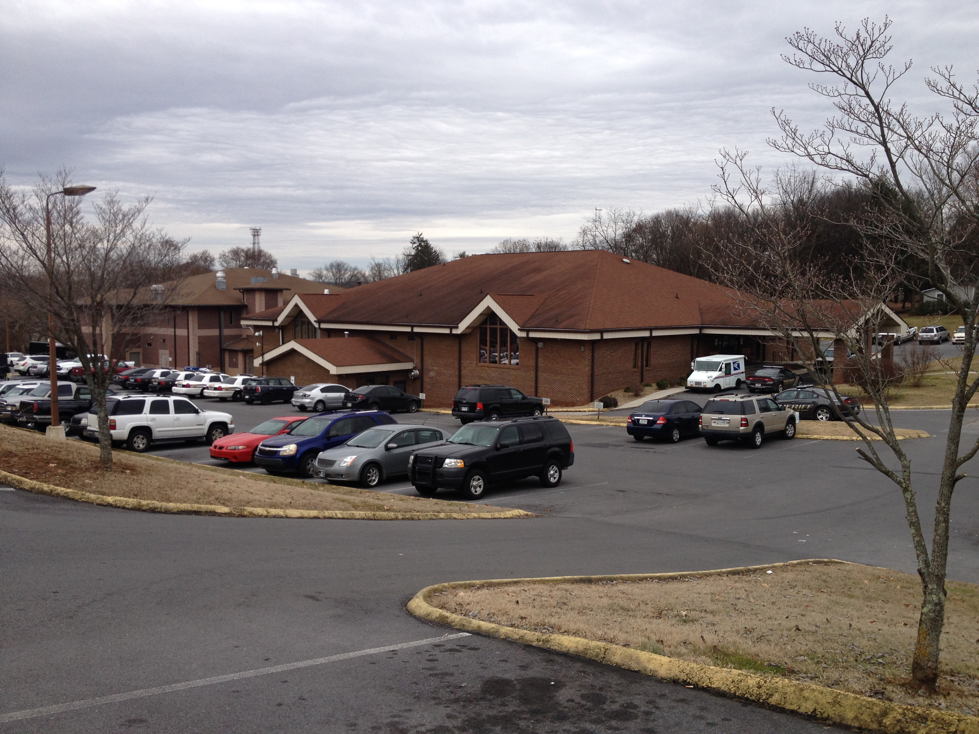
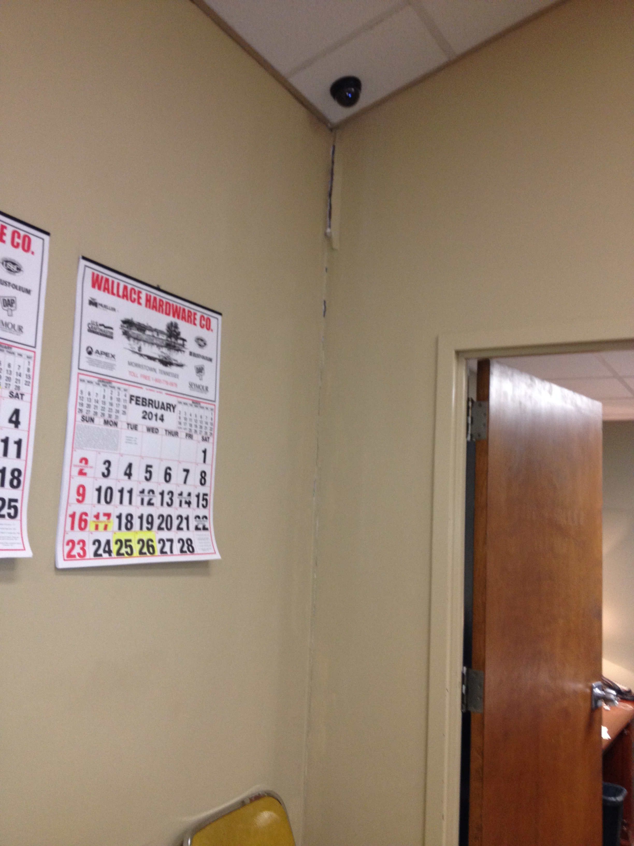
Current Conditions – Justice Center
Justice Center Exterior
Crack in Wall – Criminal Court

Slide 4
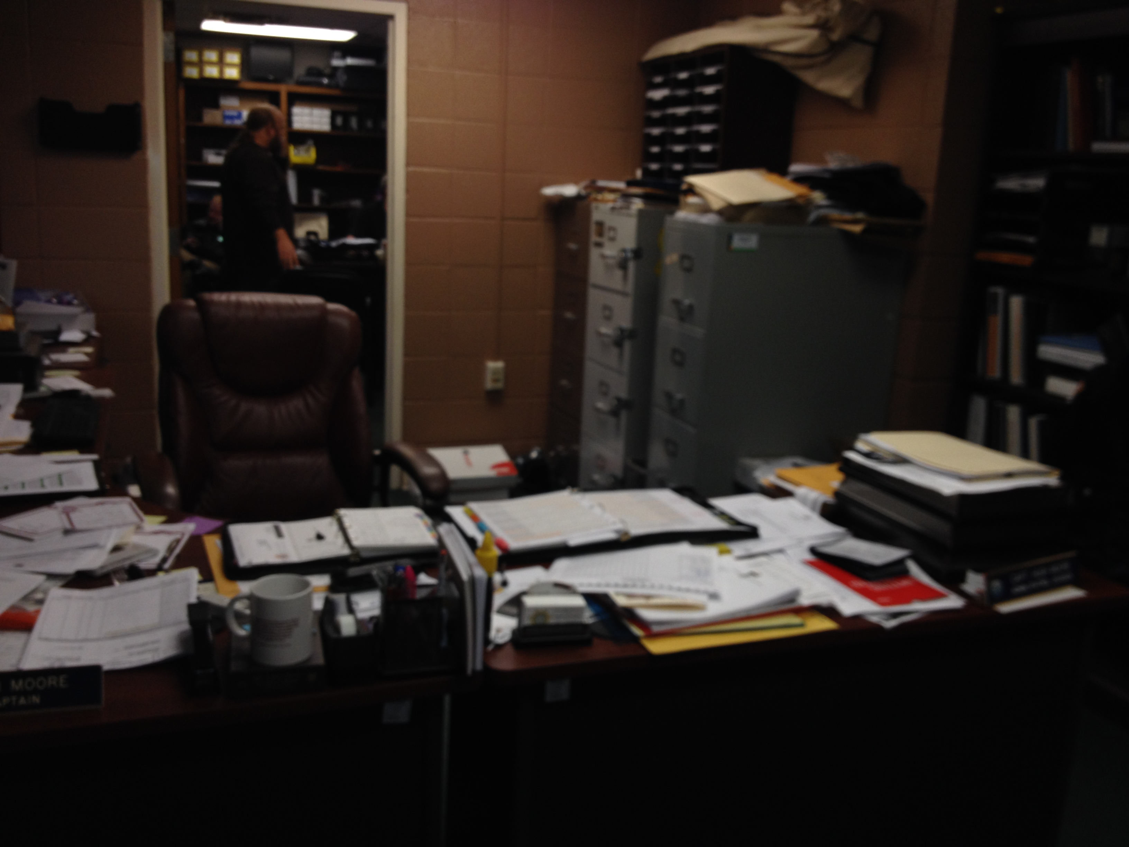
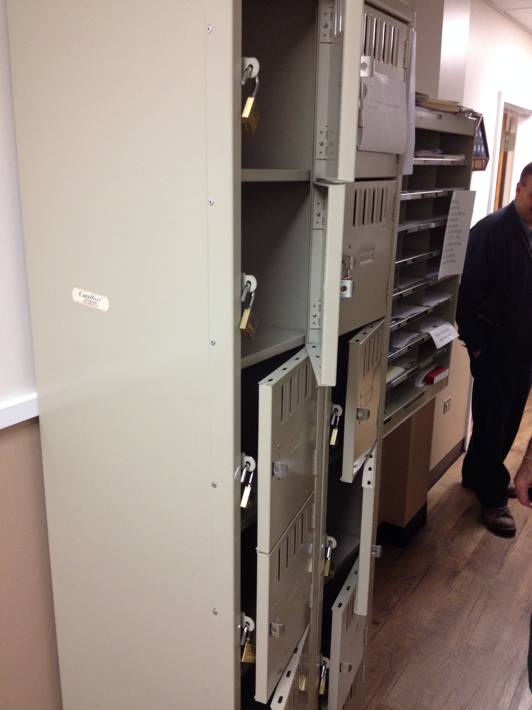
Current Conditions – Sheriff’s Department
Office Space
Lockers

Slide 5
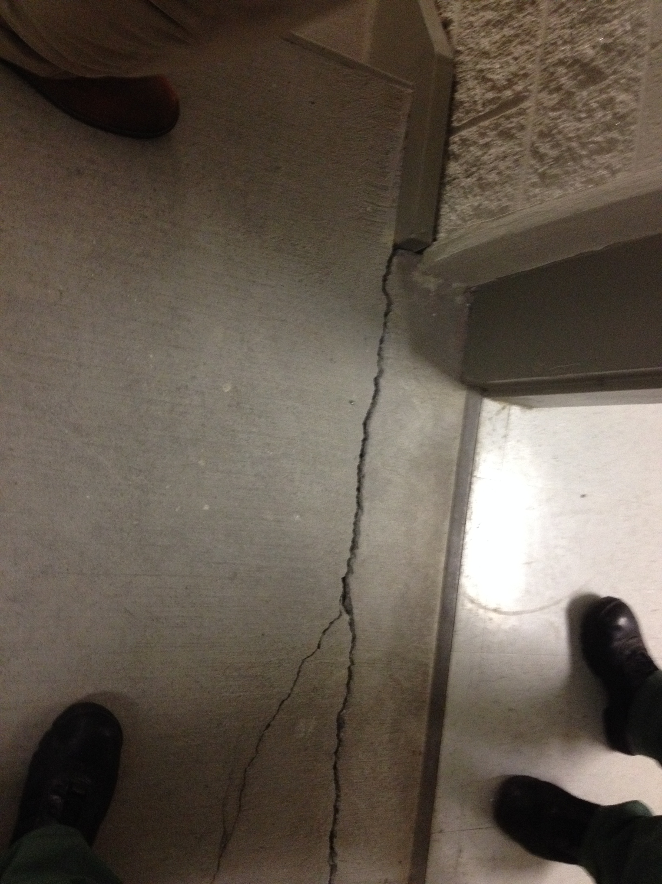
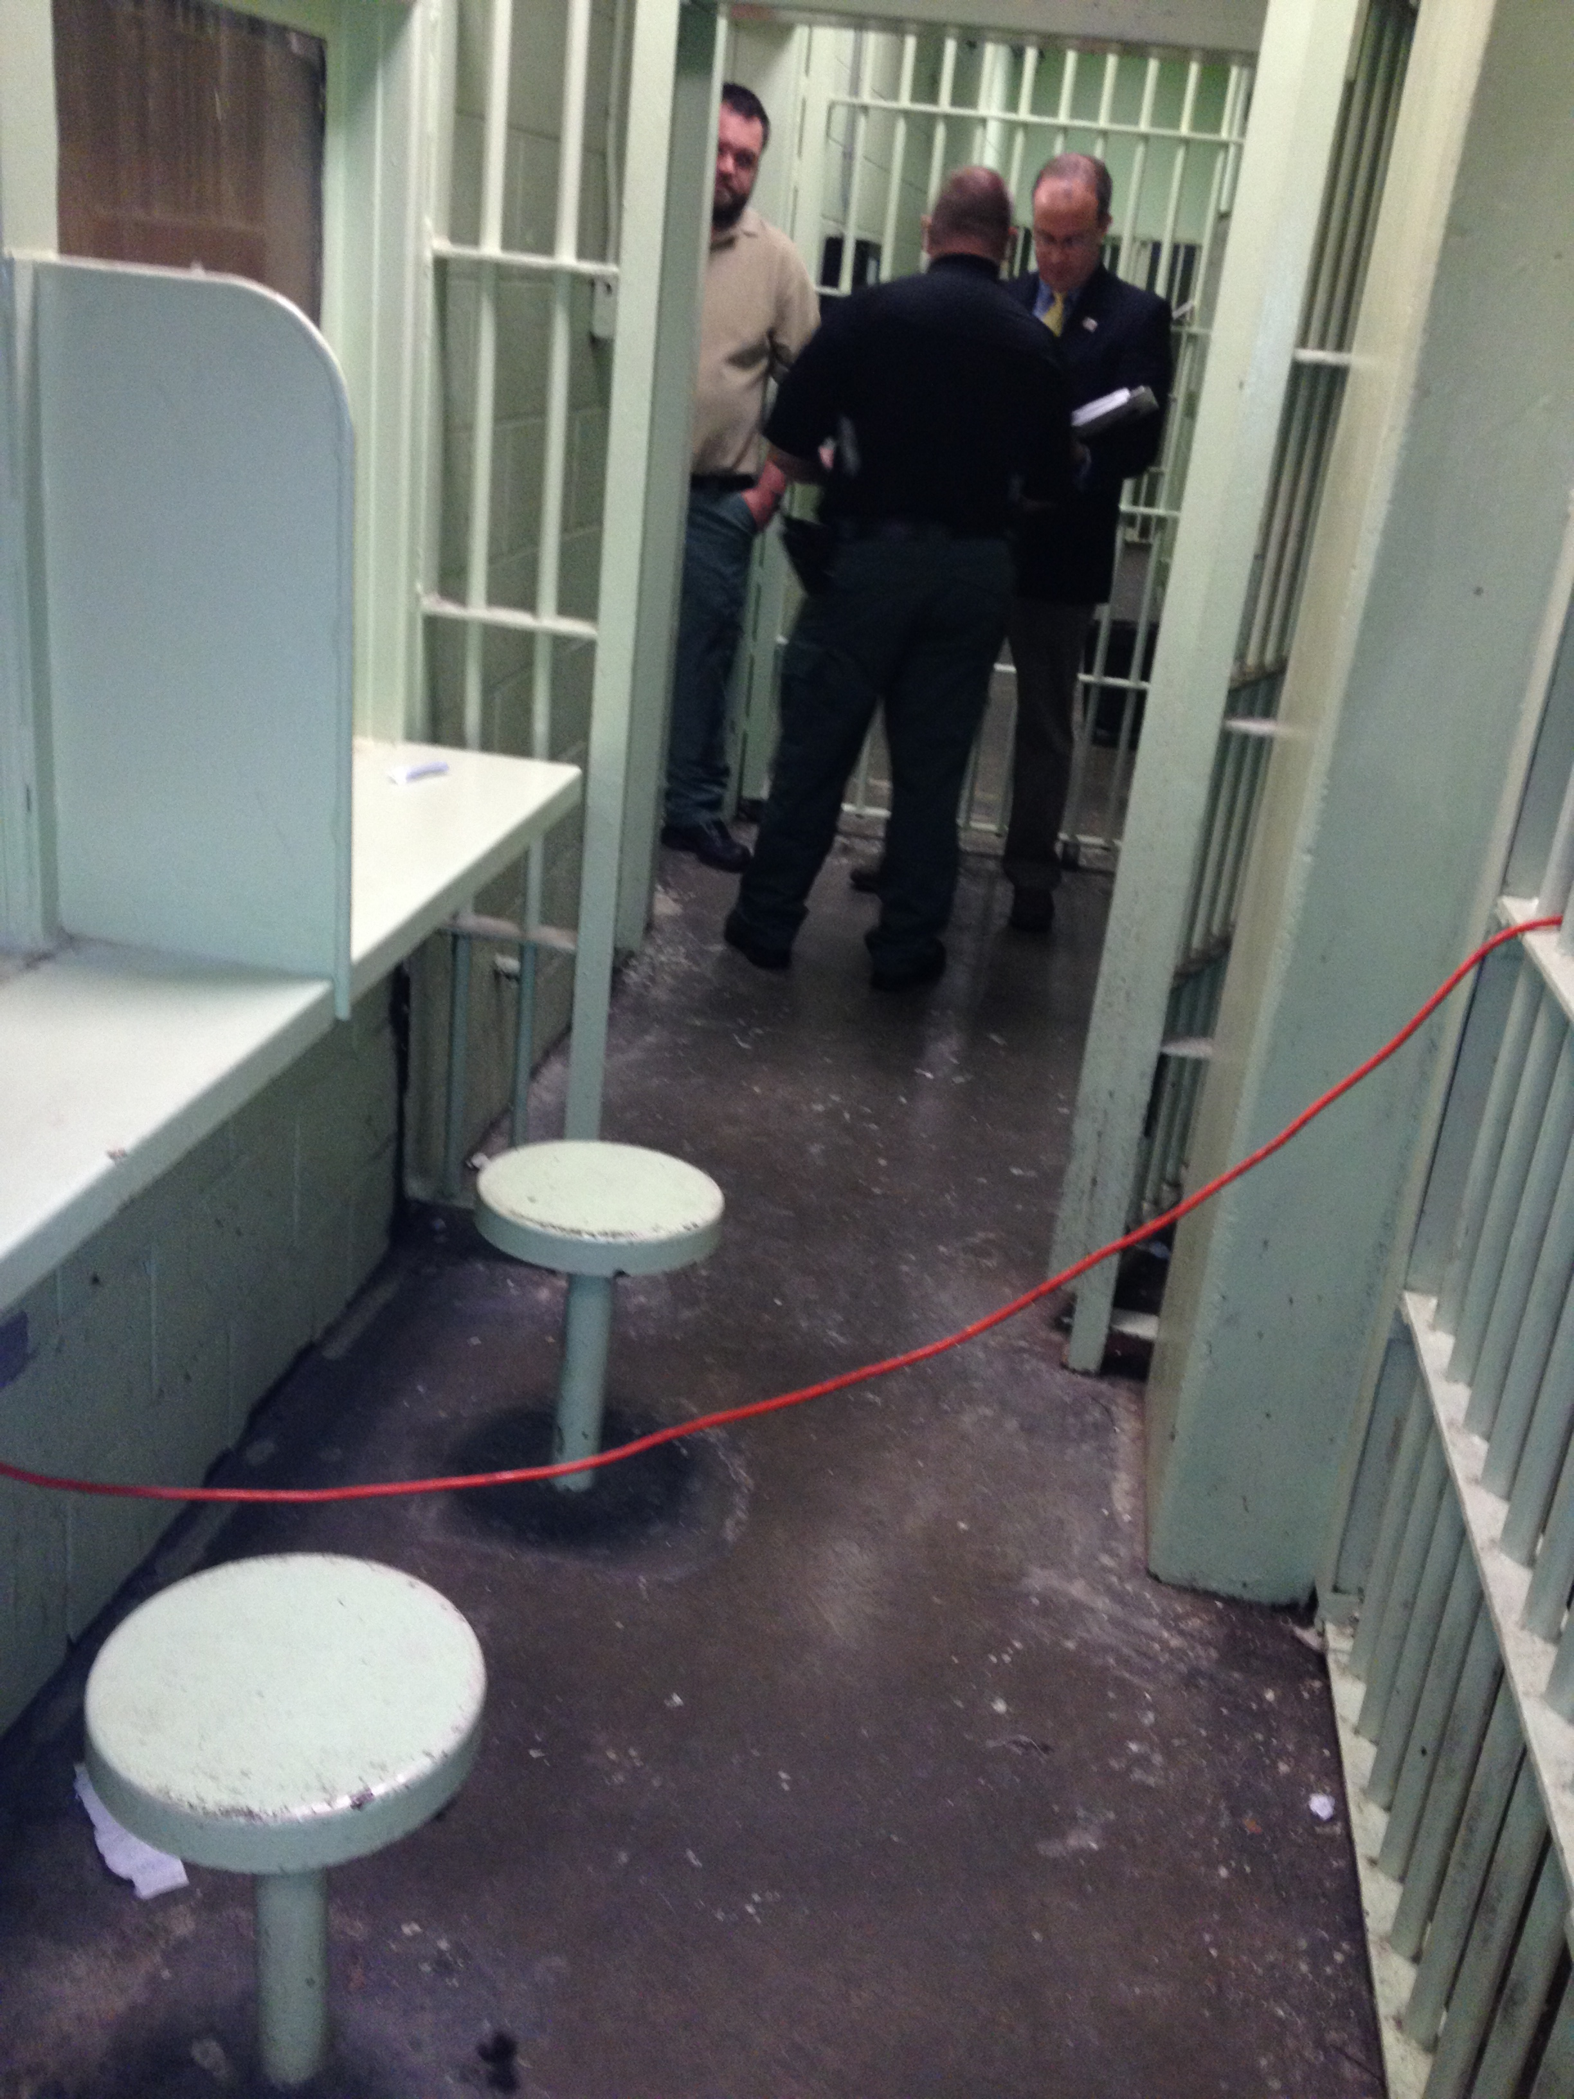
Current Conditions – Jail
Stairwell Crack – Jail Addition
Main Jail

Slide 6
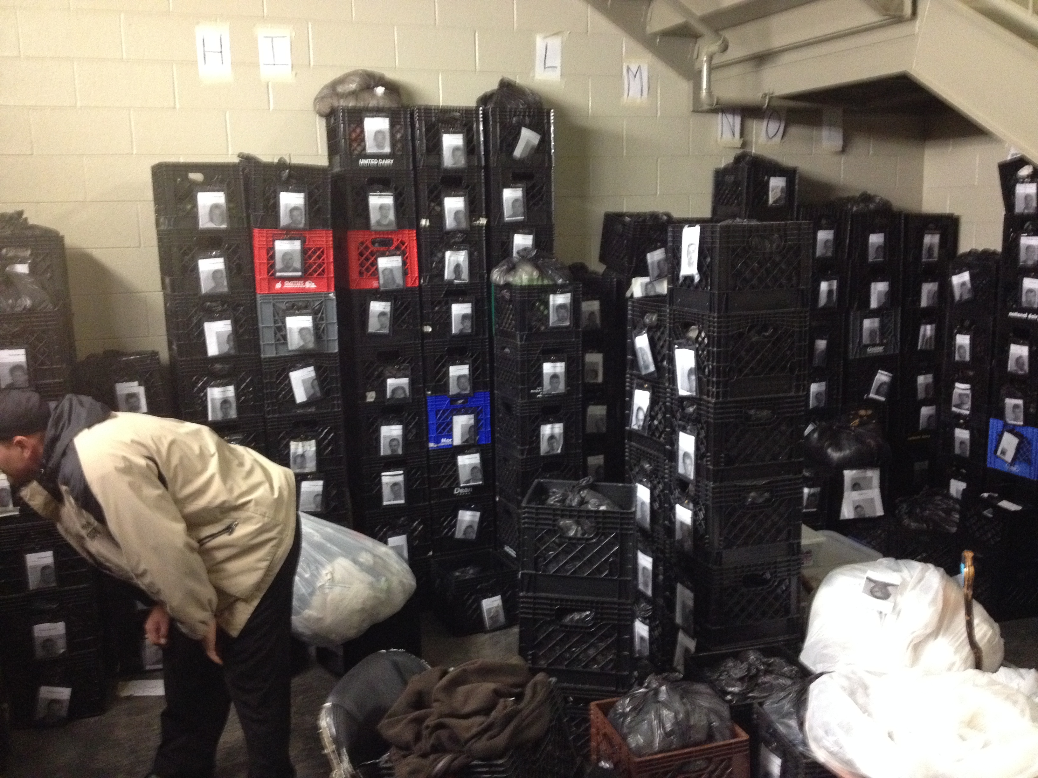
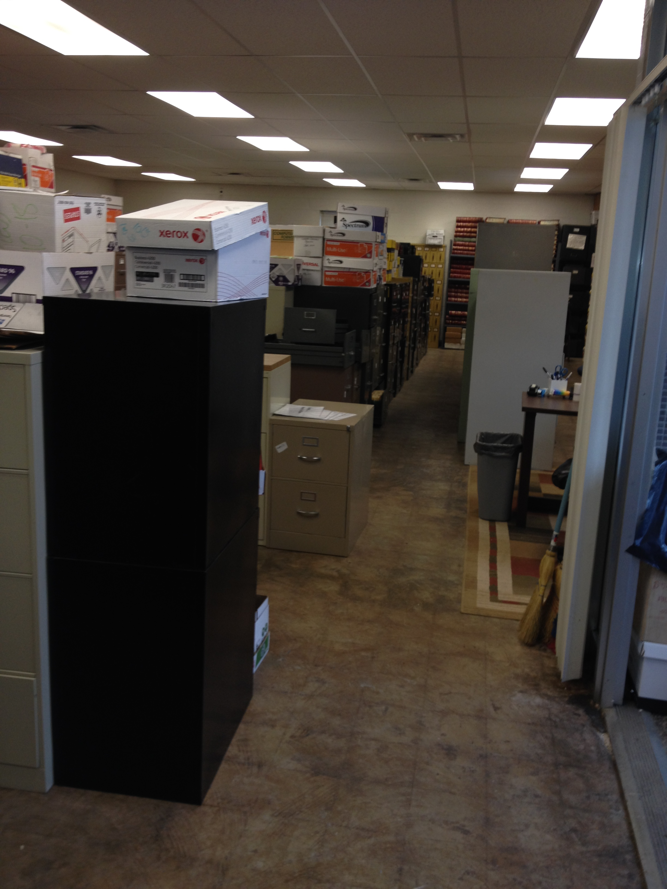
Current Conditions – Storage
Male Jail Inmate Property Storage
Storage Annex

Slide 7
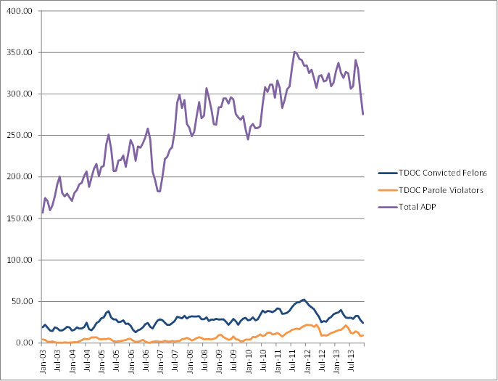
Historical Trends: Jail ADP

Slide 8
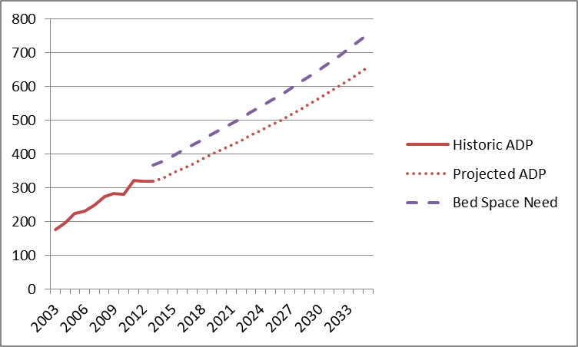
System Projections: Status Quo

Slide 9
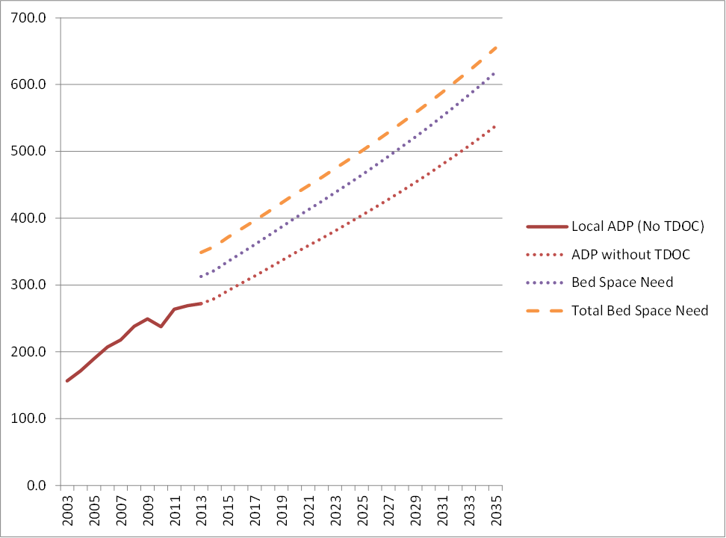
System Projections: Recommended

Slide 10
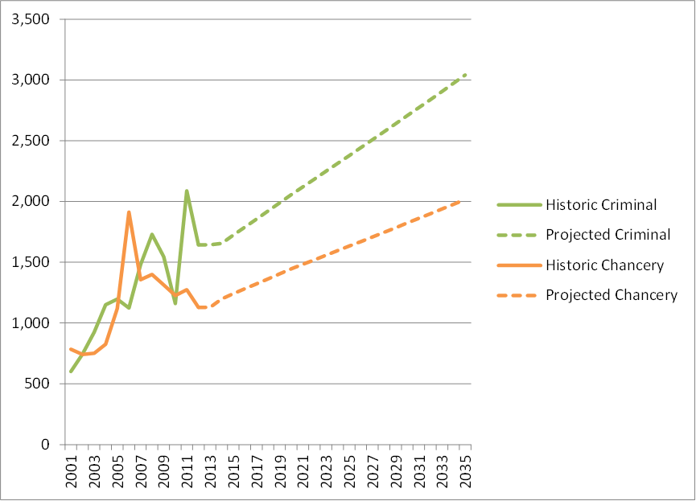
Historical Trends: Court Filings

Slide 11
Feasibility of Expansion/Renovation: Courts
Need for a High-Volume Criminal Court (Seating for 150)
Need to expand the number of Courtroom spaces
Space not available in County Courthouse or Justice Center to accommodate additional Courtrooms and Space Requirements

Slide 12
Feasibility of Expansion/Renovation: Sheriff
RECOMMENDED SHERIFF SPACES
FOR HAMBLEN COUNTY, TENNESSEE
Space
Office/Administrative Spaces
Executive Staff Offices
Administrative Workspaces
Detective Workspaces
Patrol Workspaces
Interview Rooms
Reception Counter w/ Work Area
Public Waiting Area
Conference Rooms
Support Spaces
Lobby
Muster/Training Room
Locker/Shower/Restroom
Evidence Storage
Mail Room
Copy/File Room
Staff Break Room
Storage
Vehicle Garage
Total Building Gross Square Feet: 27,759
Source: CGL, April 2014
Sheriff’s Department currently housed in limited spaces within the Justice Center
No dedicated spaces for Investigators to interview individuals
Anticipated personnel growth cannot be accommodated in current space

Slide 13
Feasibility of Expansion/Renovation: Jail
Plan should be Developed for a New Jail
Initial Phase to Include Enough Housing to Meet Intermediate Needs
Core should be built for Long-Term Needs
Housing Should be a Variety of Dormitory and Cellular Design
RECOMMENDED DETENTION SPACE
FOR HAMBLEN COUNTY, TENNESSEE (2035)
Spaces for 655 Inmate Beds | Square Feet
Housing | 134,396
Administration | 15,188
Programs | 13,145
Inmate Services | 12,962
Intake/Release/Transfer | 14,578
Support Services | 31,241
Total Building Gross Square Feet | 221,510
Source: CGL, April 2014
Proper Inmate Program Space Should also be Included

Slide 14
Planning for Future Needs
Multiple Configurations Considered for New Courts Facility and Jail
Single-Story Structures would Require the Most Land
3 Options Considered: High, Medium and Low Acreage for the Facilities
ESTIMATED COMBINED LAND REQUIREMENTS FOR JUSTICE FACILITIES (2035)
Component | Low Acreage | Mid Acreage | High Acreage
Courts | 3.64 | 3.99 | 5.02
Sheriff’s Department | 1.63 | 1.63 | 1.63
Jail | 5.26 | 12.16 | 18.40
Total Acreage | 10.53 | 17.78 | 25.05
Source: CGL, April 2014

Slide 15
Projected Construction Costs: Courts
Research Conducted to Estimate Cost/ Square Foot for Typical Construction for Jail, Sheriff’s Department and Courts in Eastern Tennessee
For High-Level Estimation Purposes, Cost per Square Foot Estimated at $180 for the Courts and Sheriff’s Office and $250 for the Jail
JUDICIAL CONSTRUCTION COST ESTIMATE
2014 DOLLARS
Space | Qty
High-Volume Criminal Jury Courtroom Set | 1
Large Criminal Jury Courtroom Set | 1
Circuit Non-Jury Courtroom Set | 1
General Sessions Non-Jury Courtroom Set - Div. I | 1
General Sessions Non-Jury Courtroom Set - Div. II | 1
Non-Jury, Hearing Courtroom Set | 1
Judicial Chamber Suite | 6
Judicial Support Space Set | 1
Judicial Staff Work Spaces | 1
Additional Support Spaces | 1
Building Support | 1
Total Building Gross Square Feet | 60,254
Construction Cost / BGSF ($180/SqFt) | $ 10,845,666
Architectural & Engineering Fees (7%) | $ 759,197
Construction Contingency (10%) | $ 1,084,567
Misc, Insurance, Other (3%) | $ 325,370
Total Building Cost | $ 13,014,799
Source: Compiled by CGL; April 2014

Slide 16
Projected Construction Costs:
Sheriff’s Department
SHERIFF’S DEPARTMENT CONSTRUCTION COST ESTIMATE
2014 DOLLARS
Office/Administrative Spaces
Executive Staff Offices
Administrative Workspaces
Detective Workspaces
Patrol Workspaces
Interview Rooms
Reception Counter w/ Work Area
Public Waiting Area
Conference Rooms
Support Spaces
Lobby
Muster/Training Room
Locker/Shower/Restroom
Evidence Storage
Mail Room
Copy/File Room
Staff Break Room
Storage
Vehicle Garage
Total Building Gross Square Feet: 27,759
Construction Cost / BGSF ($180/SqFt) | $ 4,996,566
Architectural & Engineering Fees (7%) | $ 349,760
Construction Contingency (10%) | $ 499,657
Misc., Insurance, Other (3%) | $ 149,897
Total Building Cost | $ 5,995,879
Source: CGL, April 2014
Cost Estimates Based on $180 per Square Foot
Land Acquisition Costs Not Included
No Potential Sites Identified in this Study
Prices Do Not Include FF&E

Slide 17
Projected Construction Costs: Jail
Not Recommended to Build All Beds at One Time
Design Core Functions for Full Capacity of 655 Beds
Option 1 – Build for the 436 Beds Needed in 2020, Continue to Use 100 Beds in Annex. New Bed Need Reduced to 336
Option 2 – Build for the Next 10-12 years. Do Not Use Annex Beds.
PROJECTED SPACE NEEDS AND CONSTRUCTION COSTS
 |  | Option 1 2020 Space Needs | Option 2 2027 Space Needs | 2035 Full Space Needs
Number of Beds: |  | 336 | 529 | 655
 | Total Building Square Footage | 149,654 | 193,128 | 221,510
Estimated $240-$260 per Square Foot |  | $250 | $250
Est. Construction Cost $250 |  | $ 37,413,550 | $ 48,282,037
Design, Contingency, Insurance (20%) |  | $ 7,482,710 | $ 9,656,407
Total Building Cost |  | $ 44,896,260 | $ 57,938,445
Source: CGL, March 2014

Slide 18
Uses for the Justice Center
Renovate Portions of the Jail for Office Space or Storage
Main Level – Court and Clerk Functions Continue
Chancery Court (or other specialty court) could operate in one of the courtrooms, while the Sheriff’s Department expands into the remaining spaces
Remodel as Office Space for Another County Department or Agency

Slide 19
Comments / Questions

Slide 20
Thank you for your time and attention

